Slide 1
A Project on Job Searching Web Application Developed BY Muhammad Abdul Wadud Azad Email: azadmiu37@gmail.com Mobile: 01625030115 ID:1245212 Round 37 Supervised By Md. Rajaul Islam Email: springapidev@gmail.com Mobile: 01686239146

Slide 2
Quick Job Inc.
Requirements:
We need to build software for Quick Job Corporation. The application will have following features:
In registration process people can be register as user and company but Superadmin can register Another people as operator.
Before confirm registration user have verify their email after that they can set their password.
If user forget password the have give email number then they will get new password setting option.
There will be four types of user like Superadmin, Operator, Company and Job-seeker.
Superadmin can see and edit every table like user, all field and table of CV making and job post but he can only see the role list. Superadmin can edit data and get information of all about.
Operator can see and edit every table like user, all field and table of CV making and job post but he can only unable to see the role list and role edit page. One more is operator will not be able to see and edit user password and personal information.
Company can upload a job post see how many Job-seeker applied in their company, who applied and they can also see the CV of Job-seeker.
Job-seeker can see how many jobs are available, what types of jobs are available, they also upload, create and edit their CV after that they will be able to apply in jobs.

Slide 3
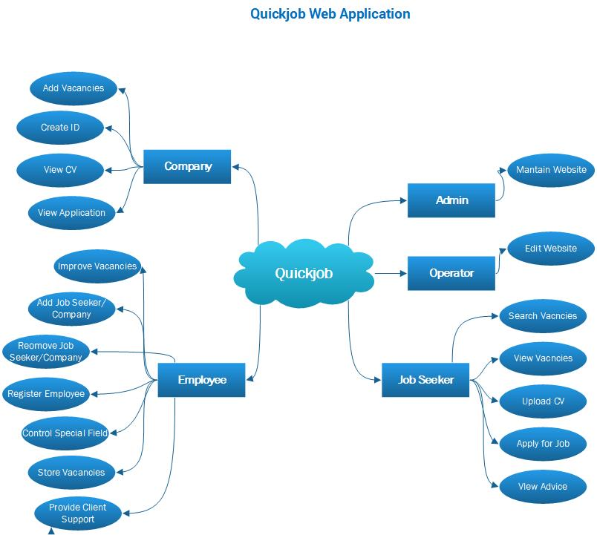
Brainstorming Diagram

Slide 4
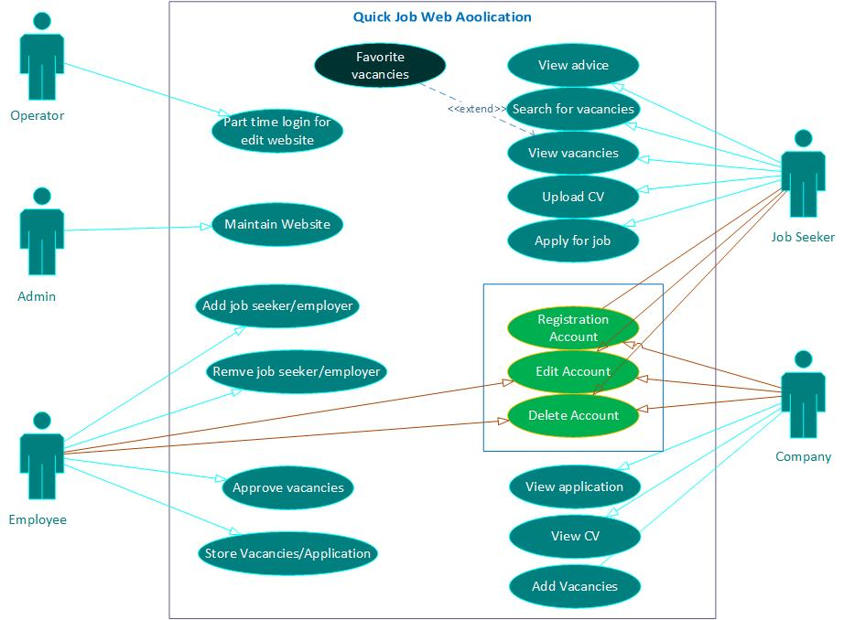
Use Case Diagram

Slide 5
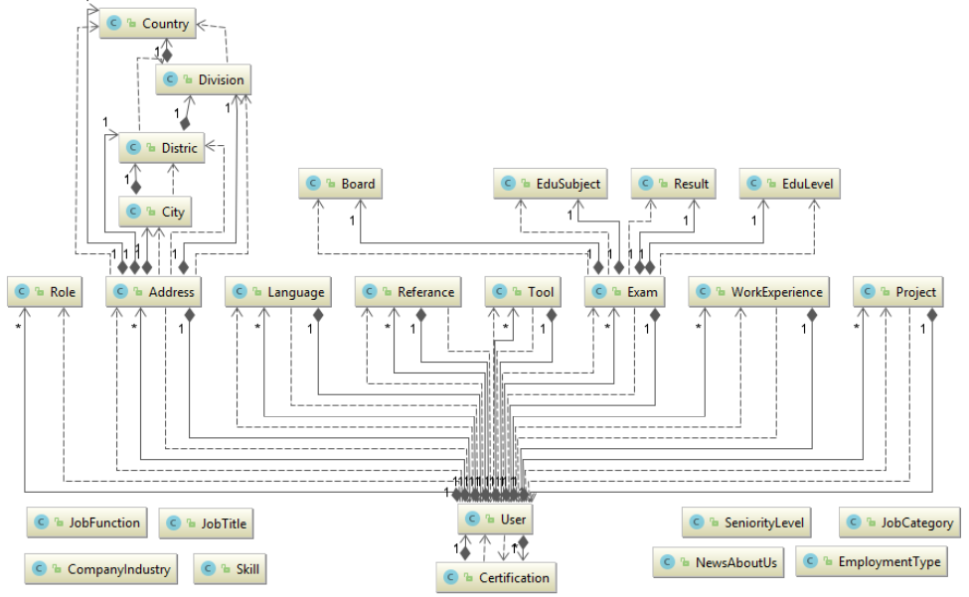
Class Diagram

Slide 6
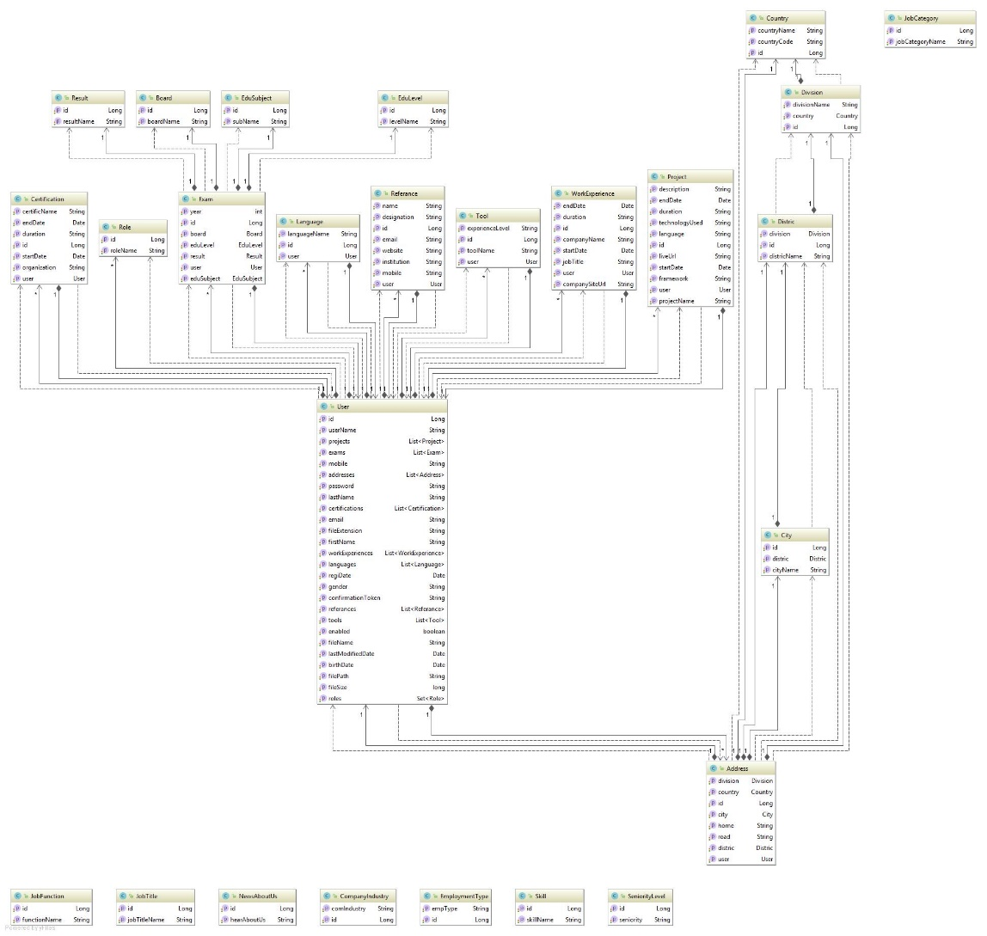
Class Diagram

Slide 7
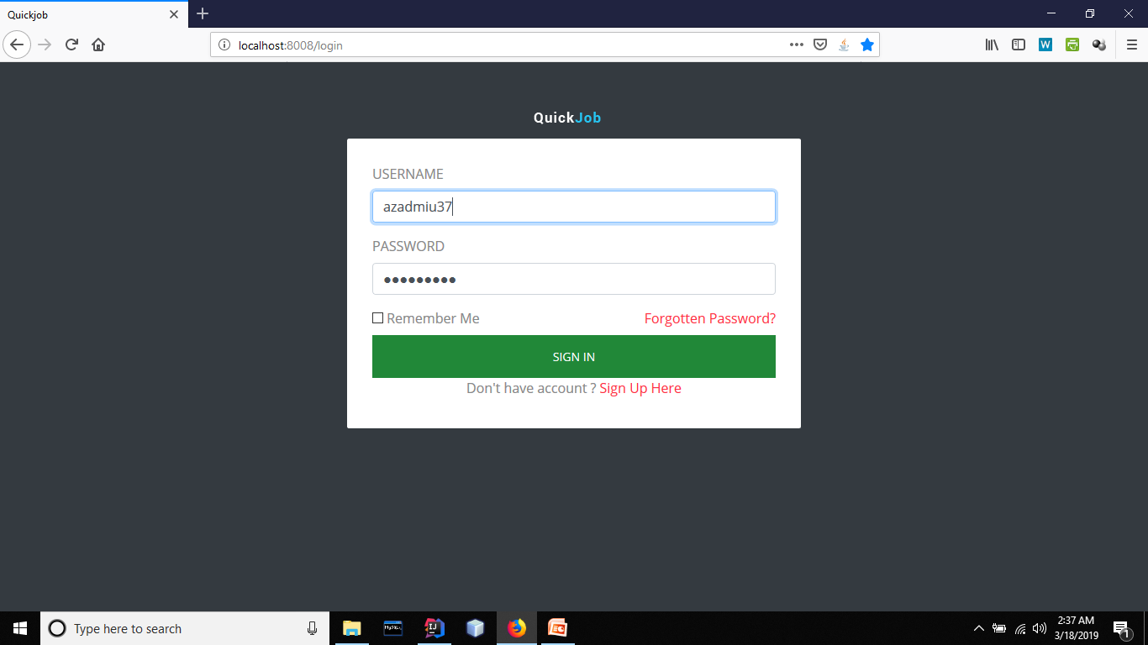

Slide 8
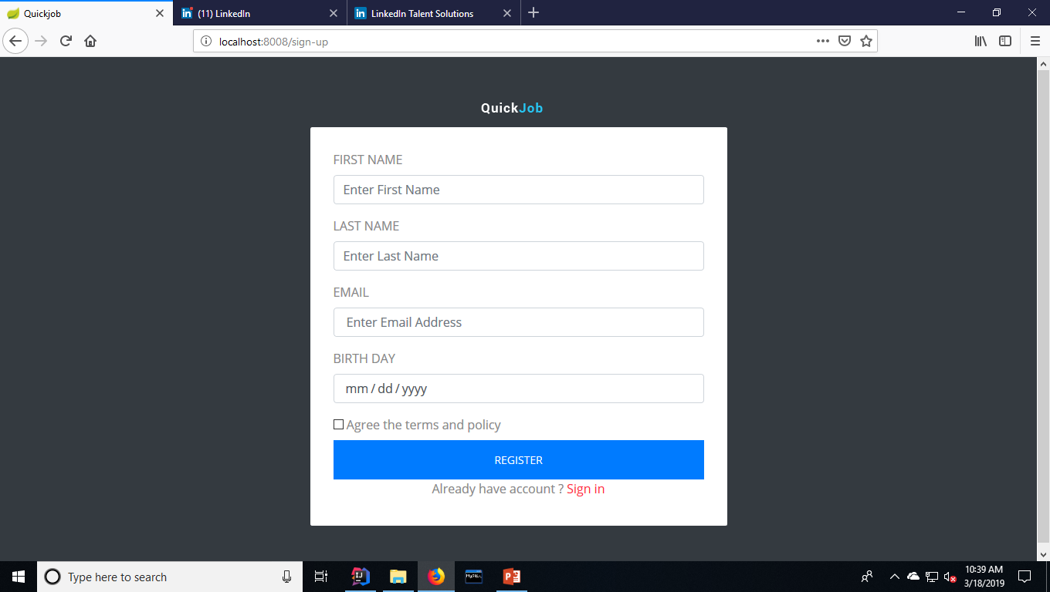

Slide 9
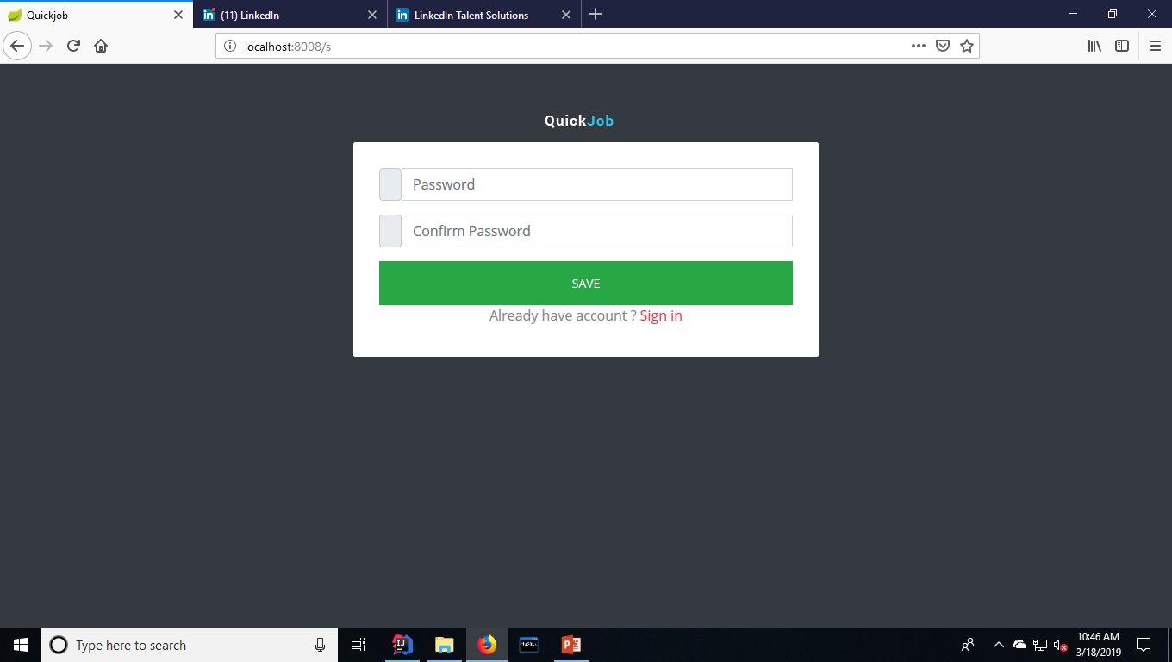

Slide 10
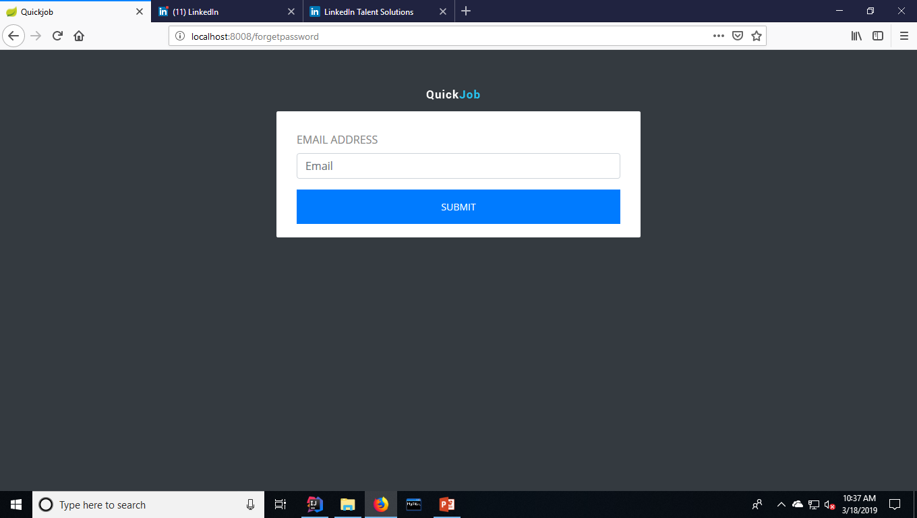

Slide 11
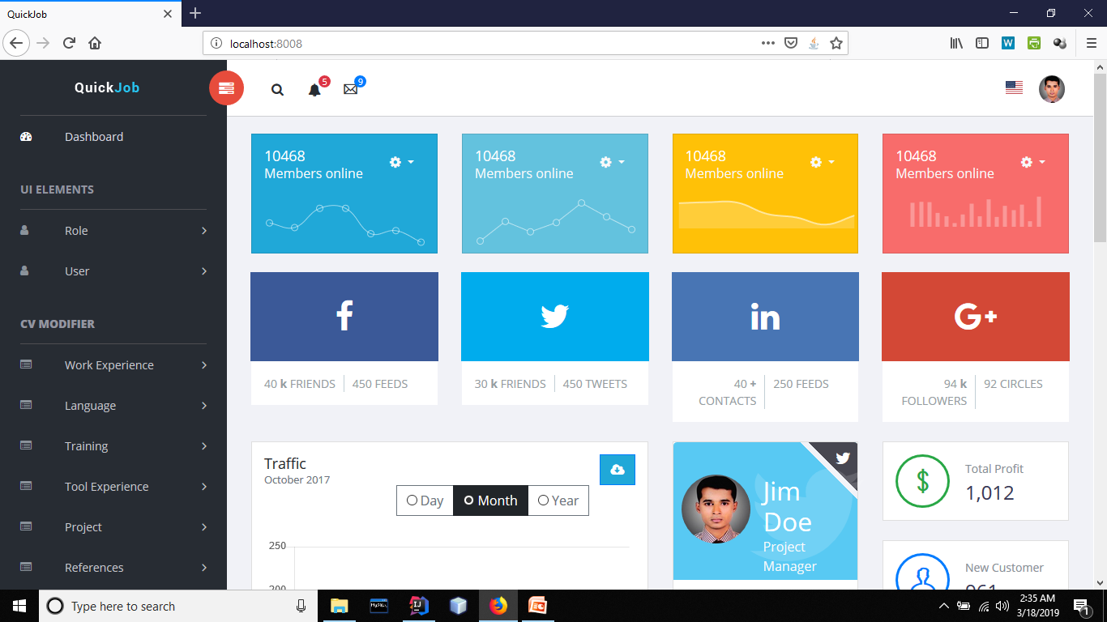

Slide 12
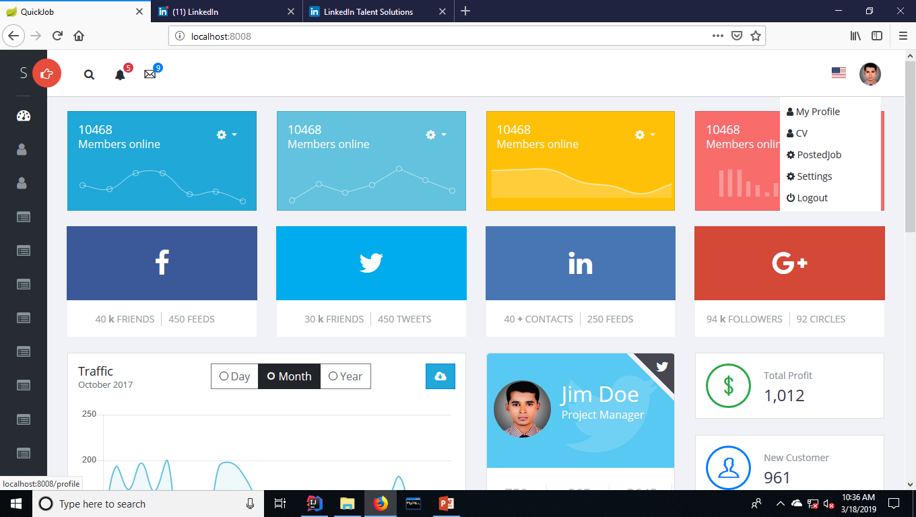

Slide 13
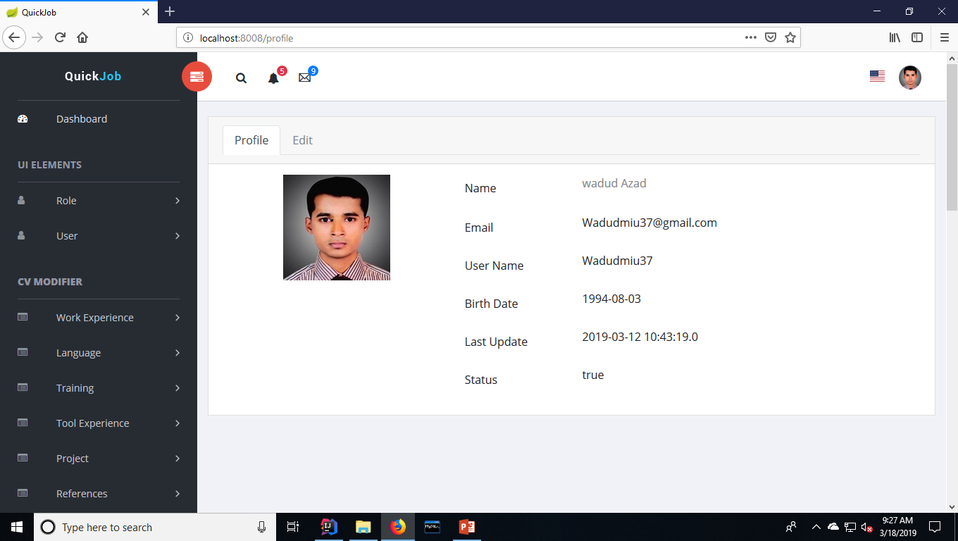

Slide 14
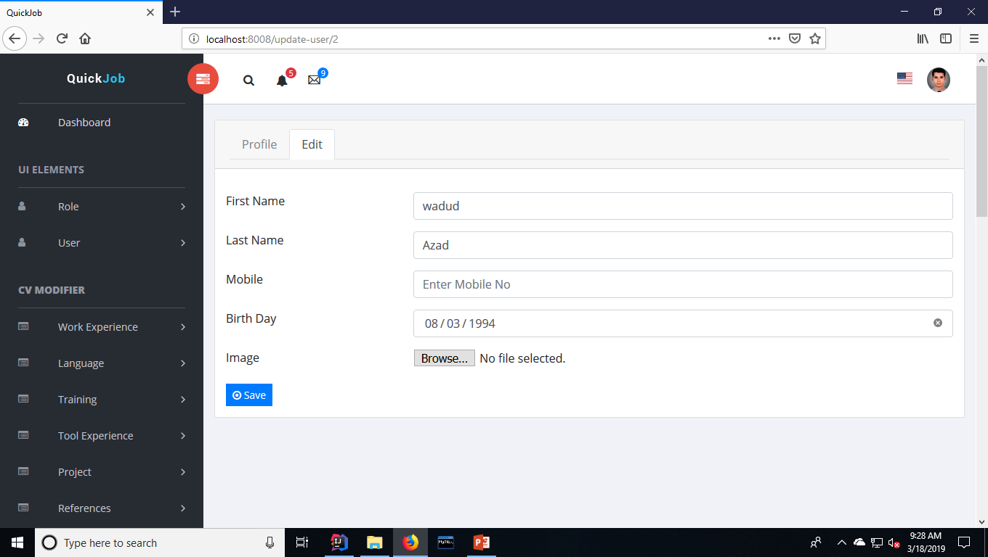

Slide 15
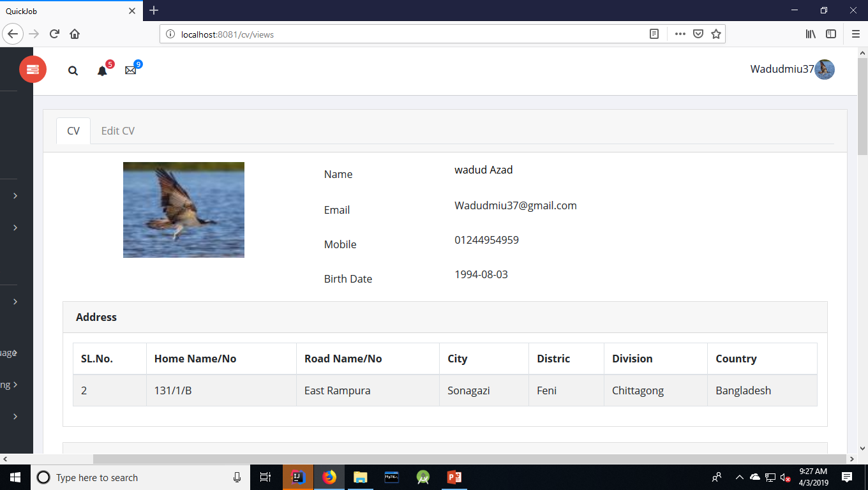

Slide 16
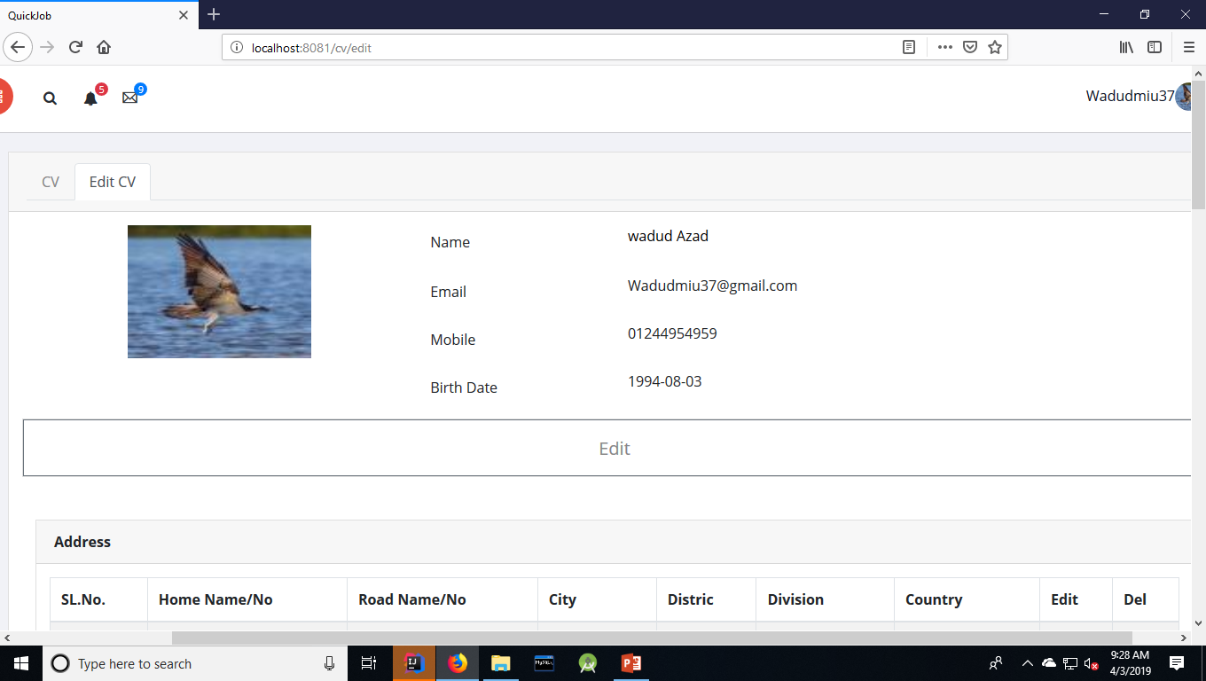

Slide 18
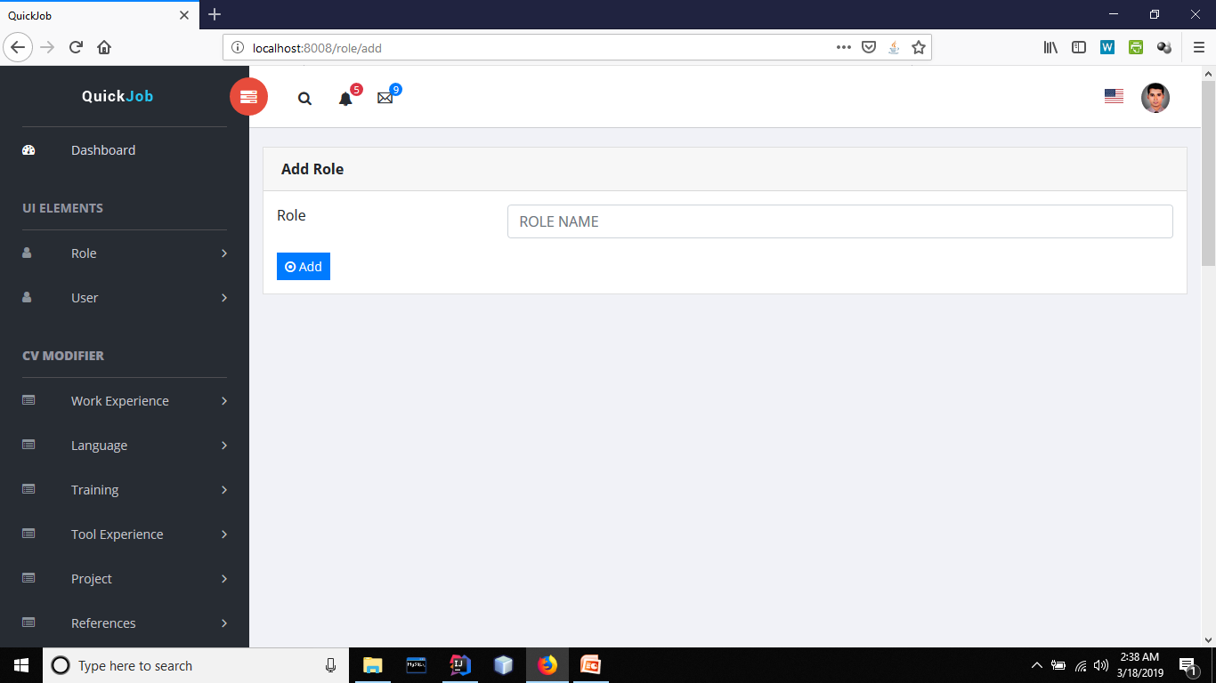

Slide 19
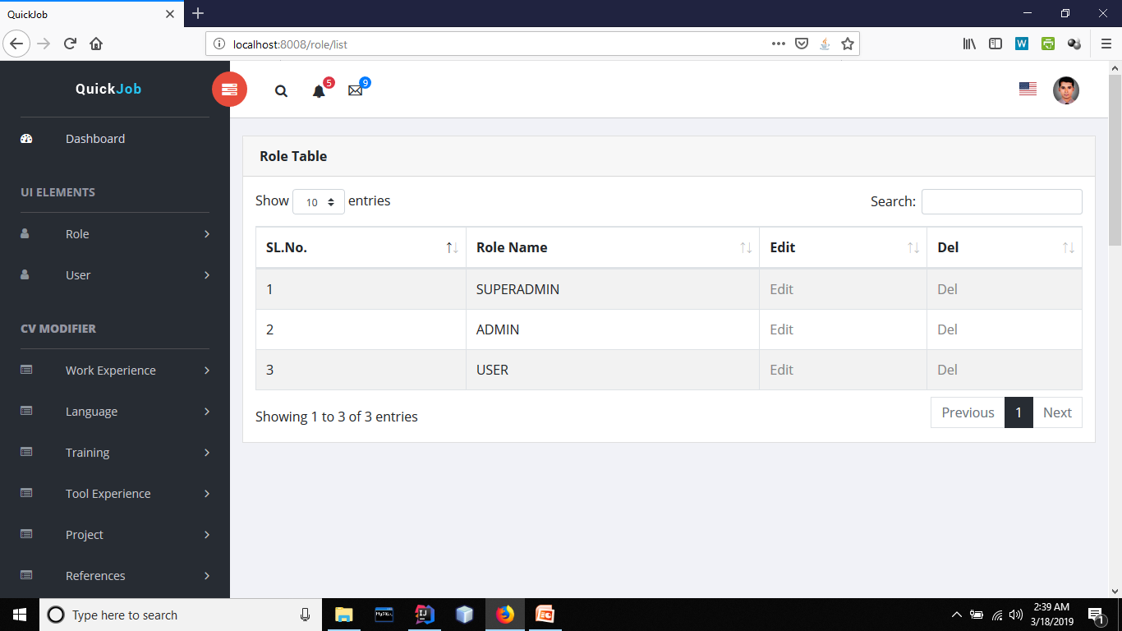

Slide 20


Slide 21
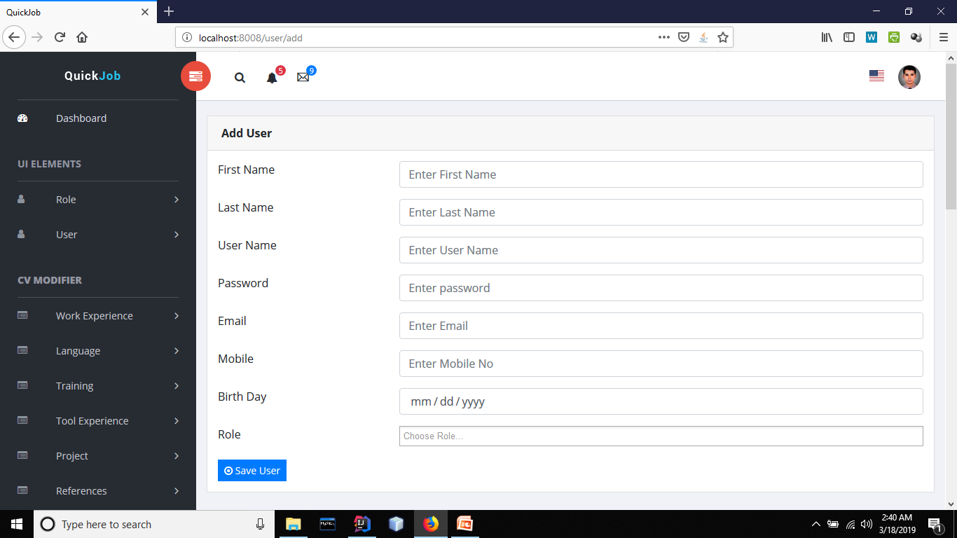

Slide 22
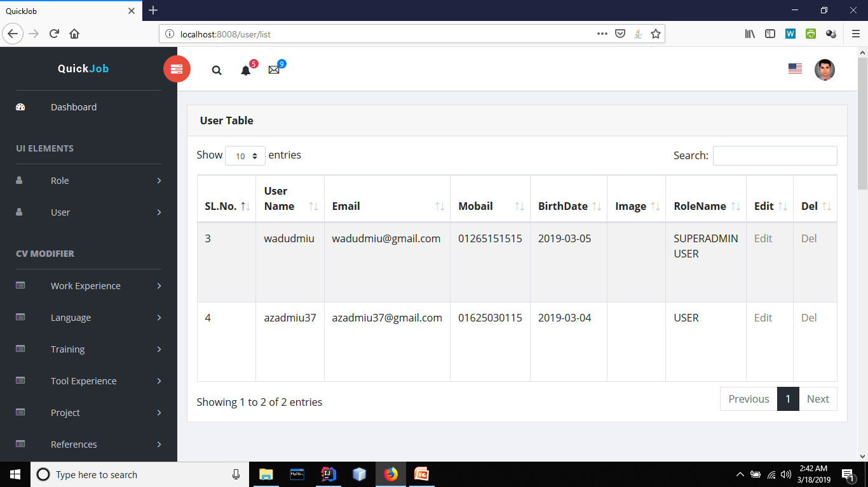

Slide 23
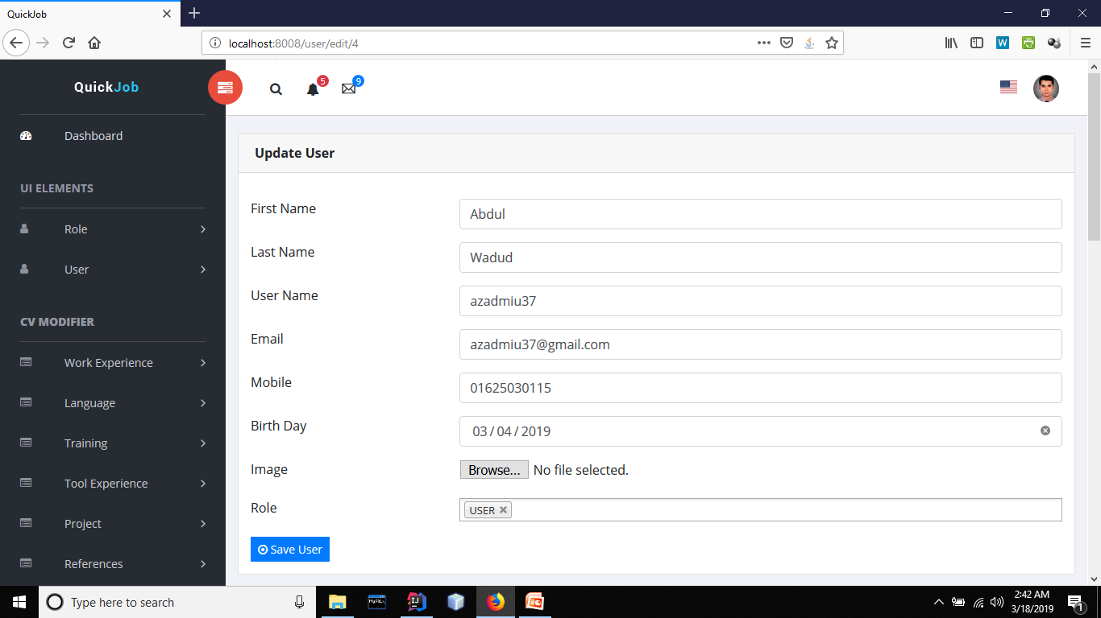

Slide 24
CV Making

Slide 25
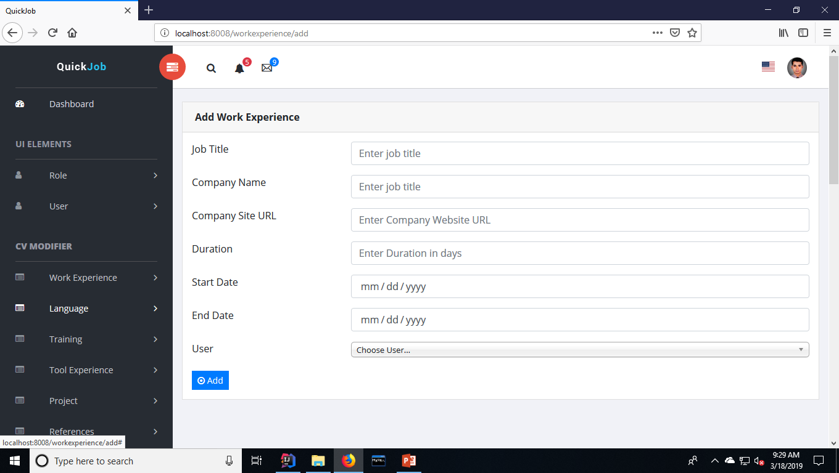

Slide 26
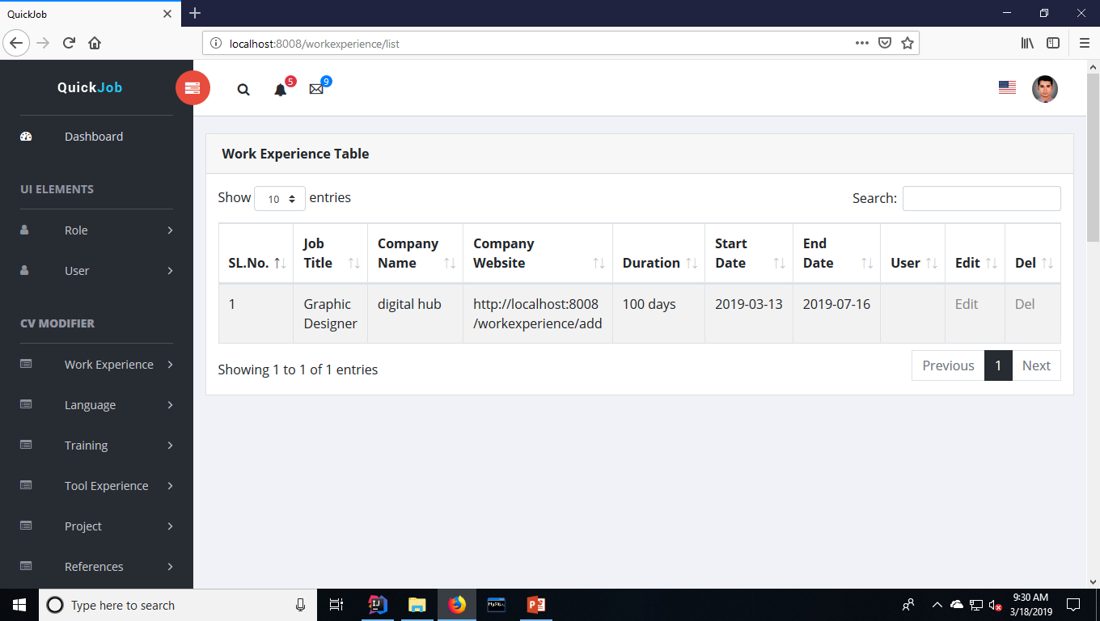

Slide 27
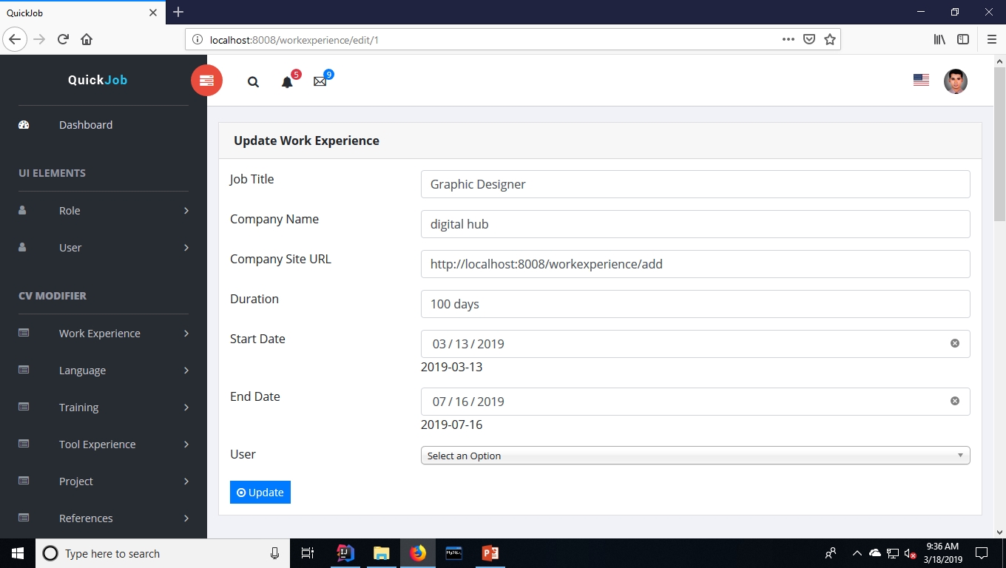

Slide 28
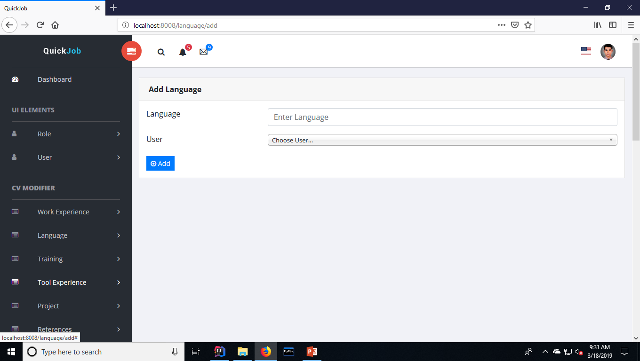

Slide 29
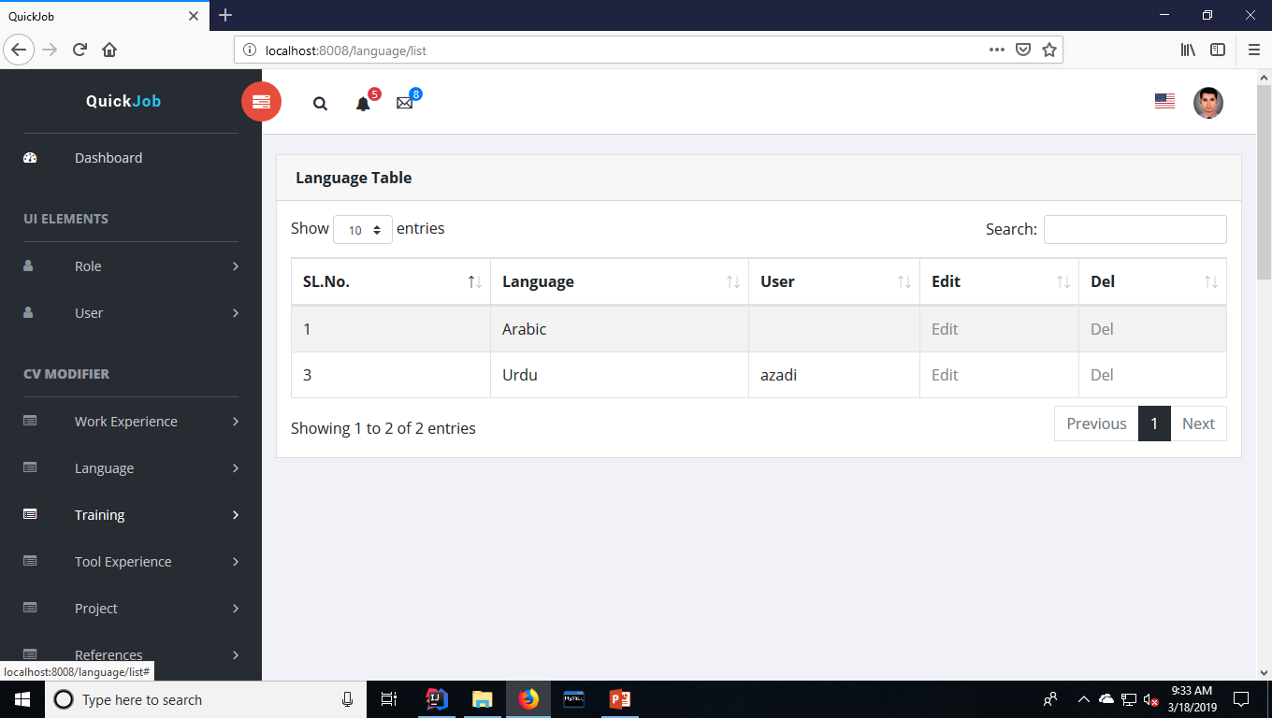

Slide 30
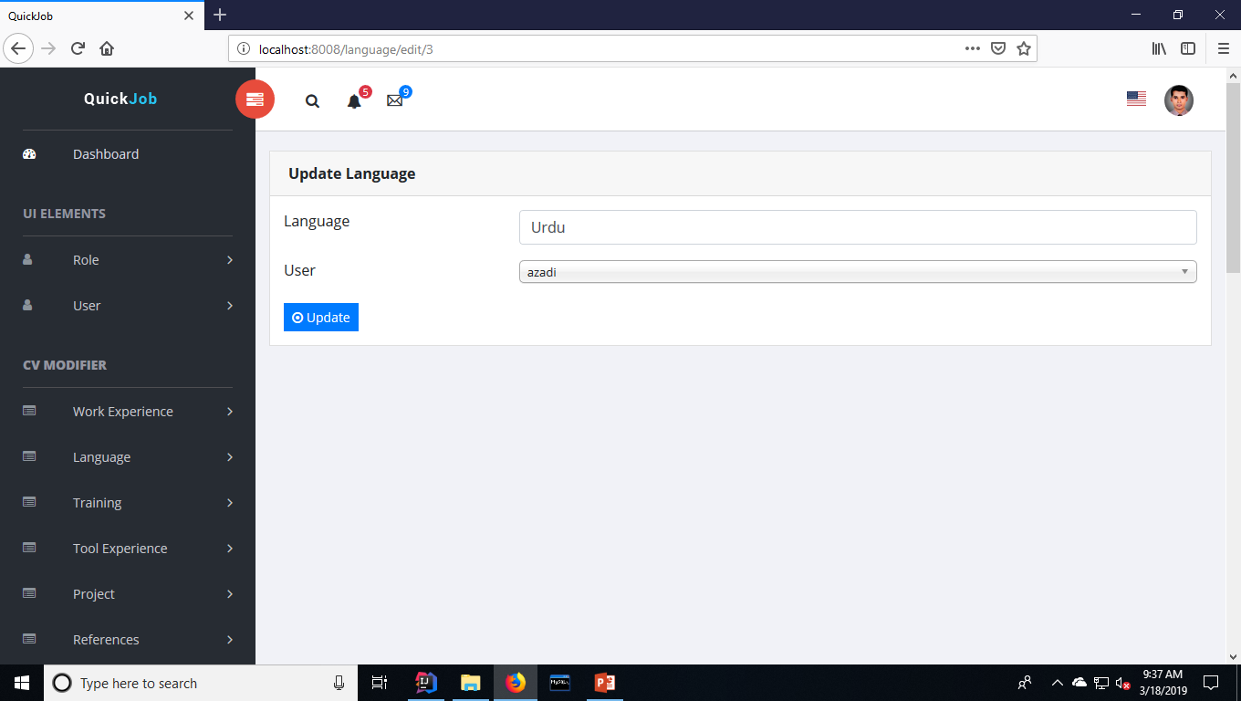

Slide 31
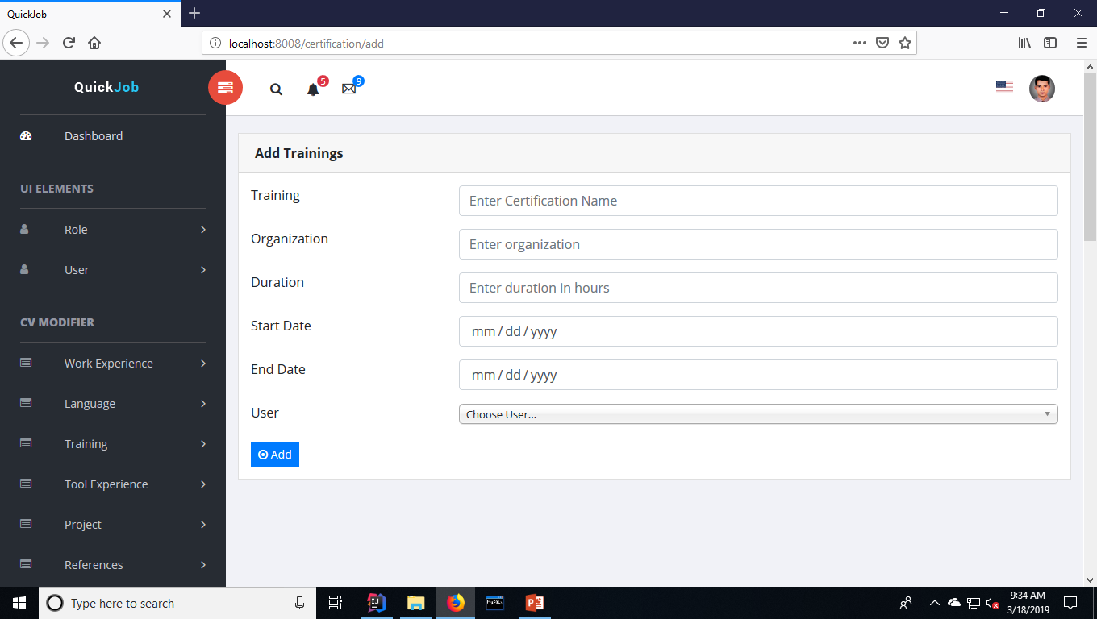

Slide 32
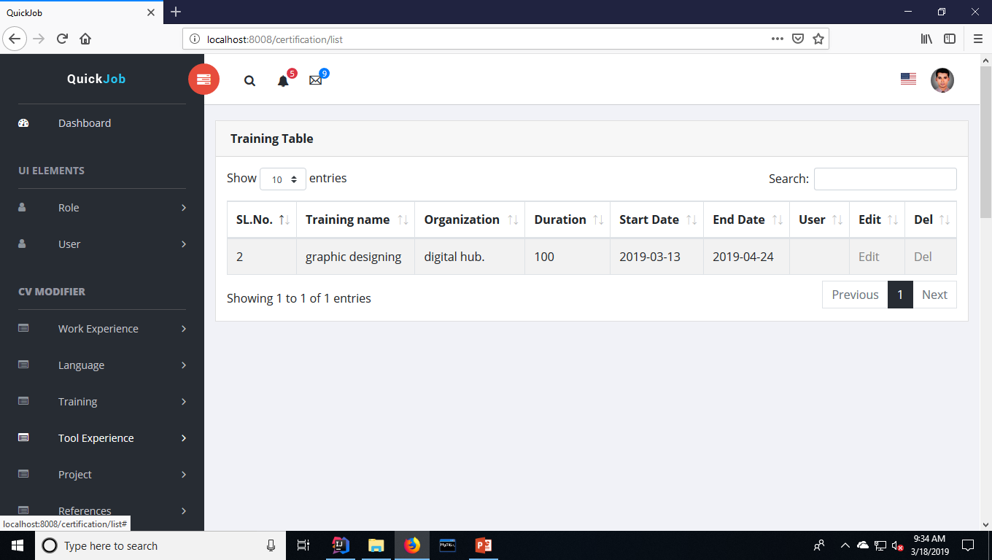

Slide 33
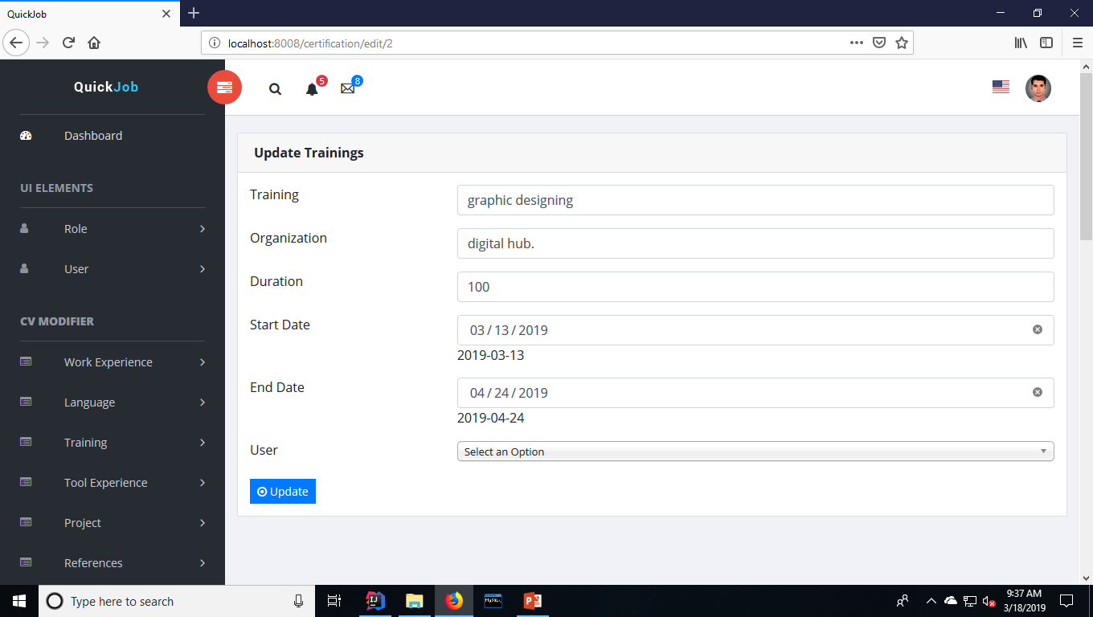

Slide 34
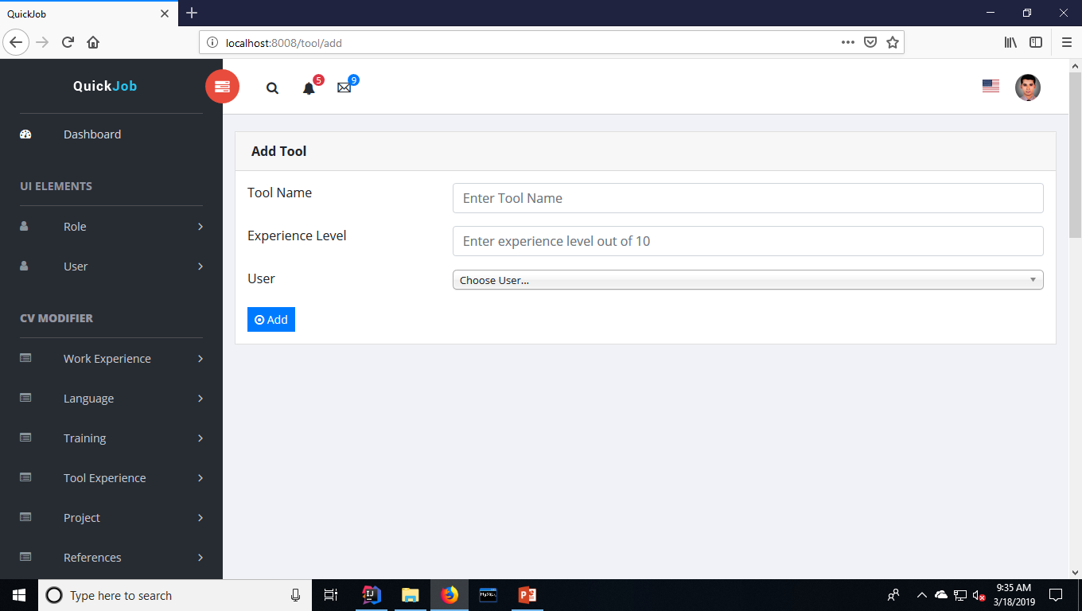

Slide 35
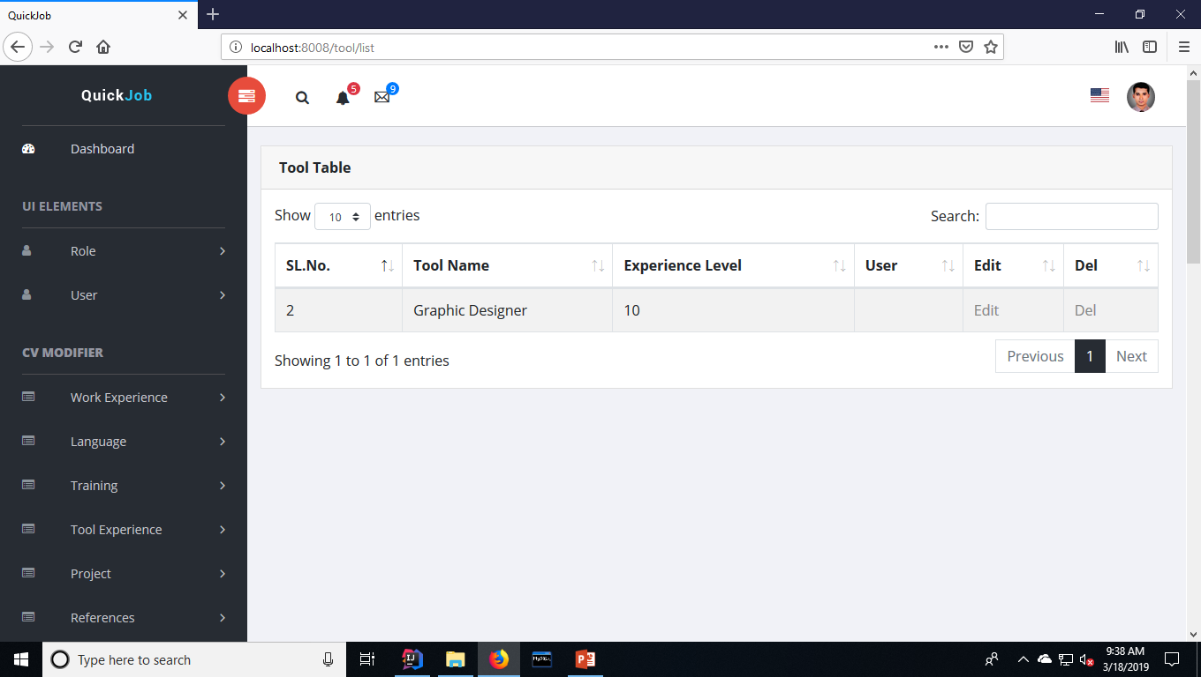

Slide 36
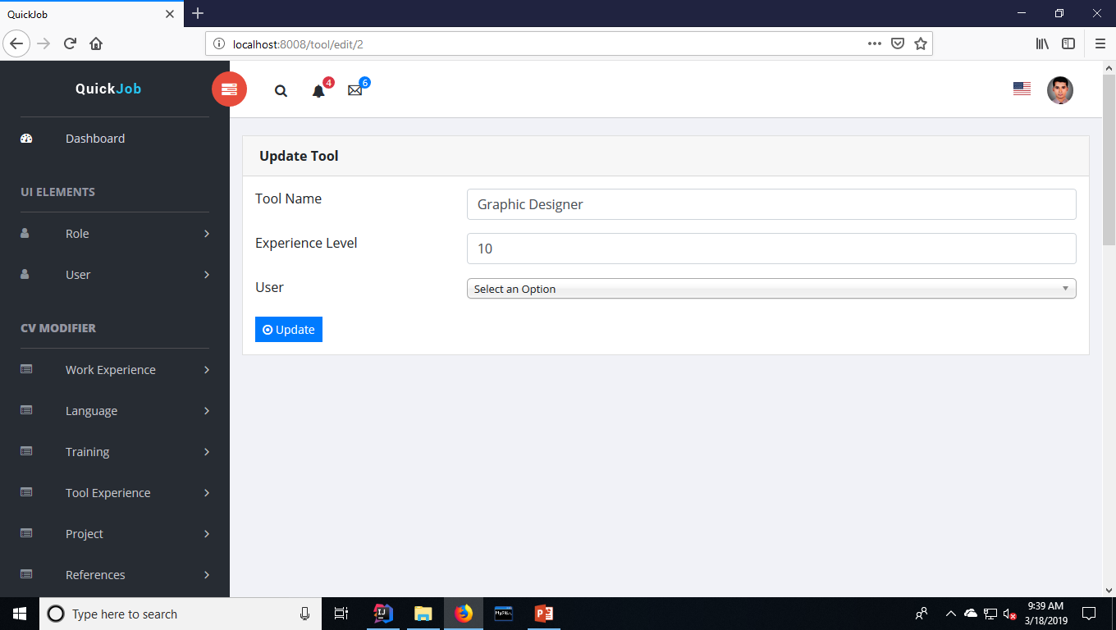

Slide 37
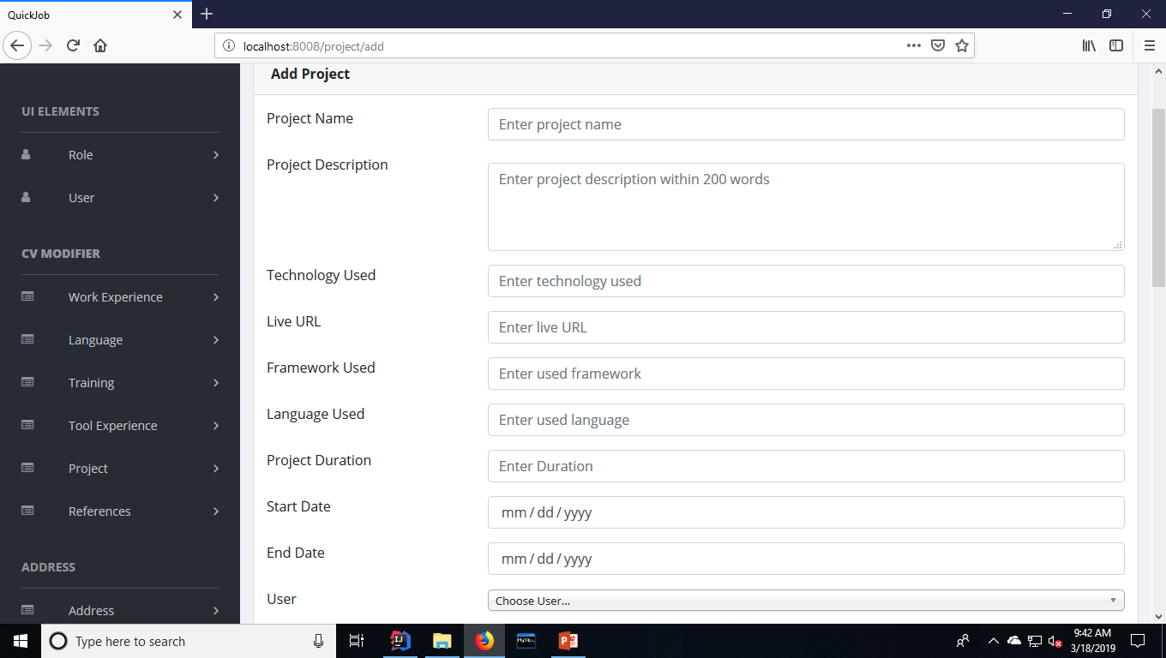

Slide 38
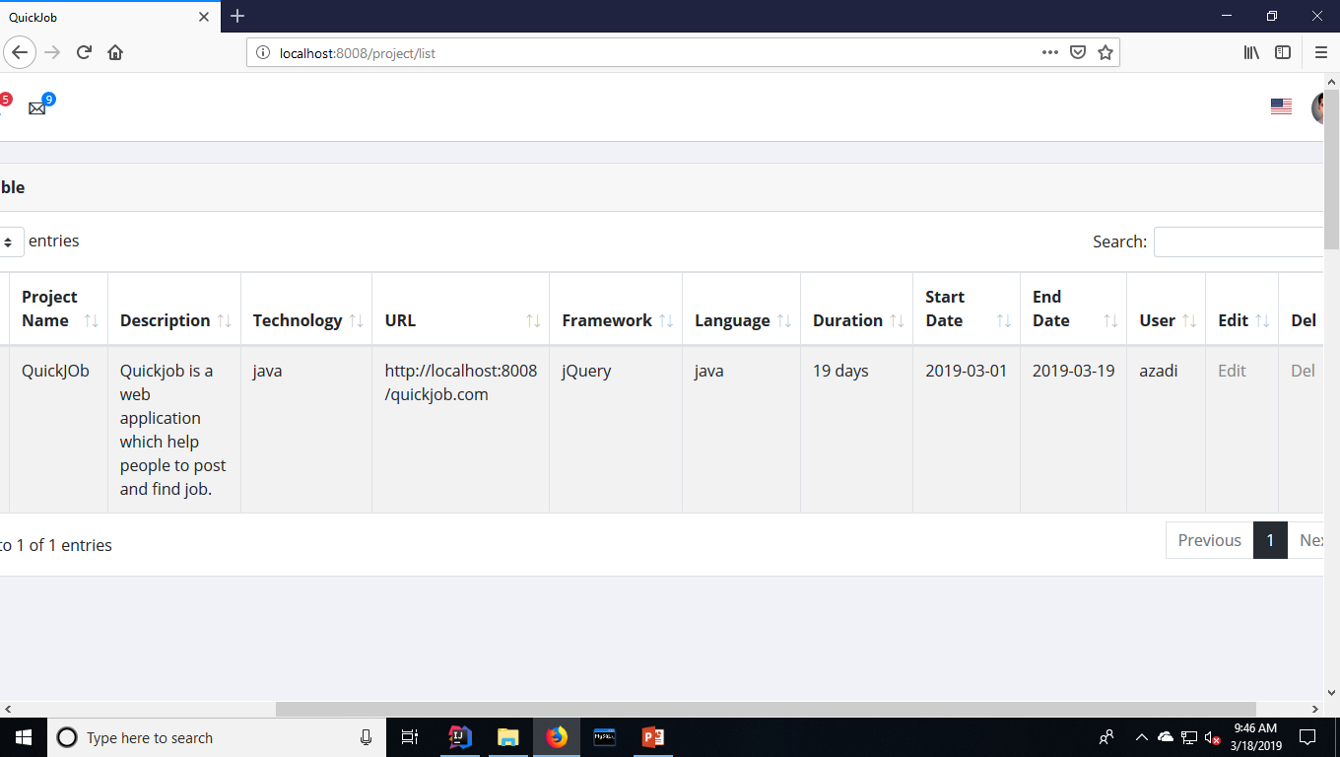

Slide 39
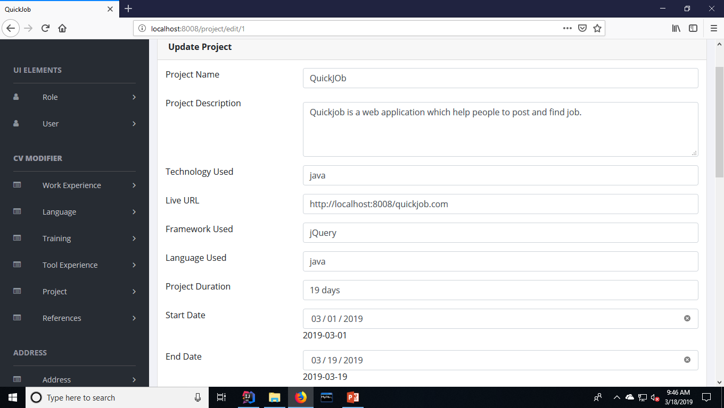

Slide 40
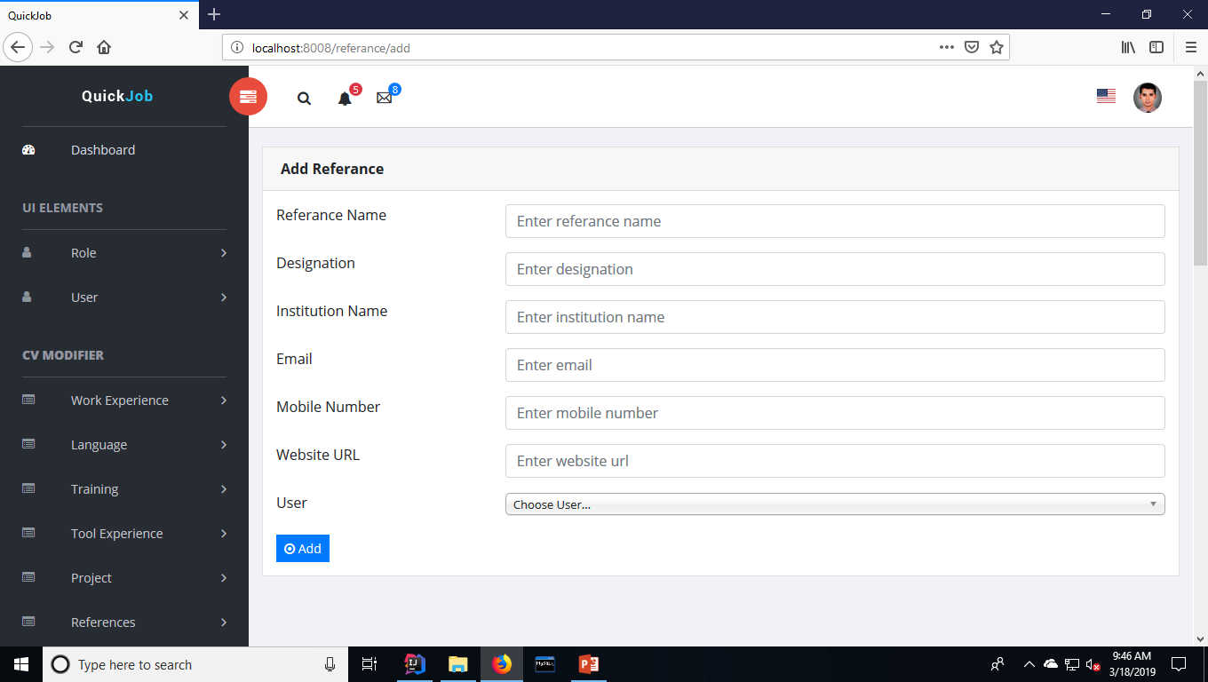

Slide 41
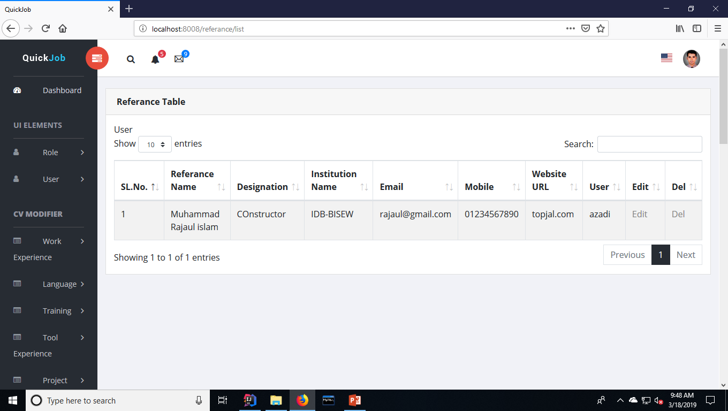

Slide 42
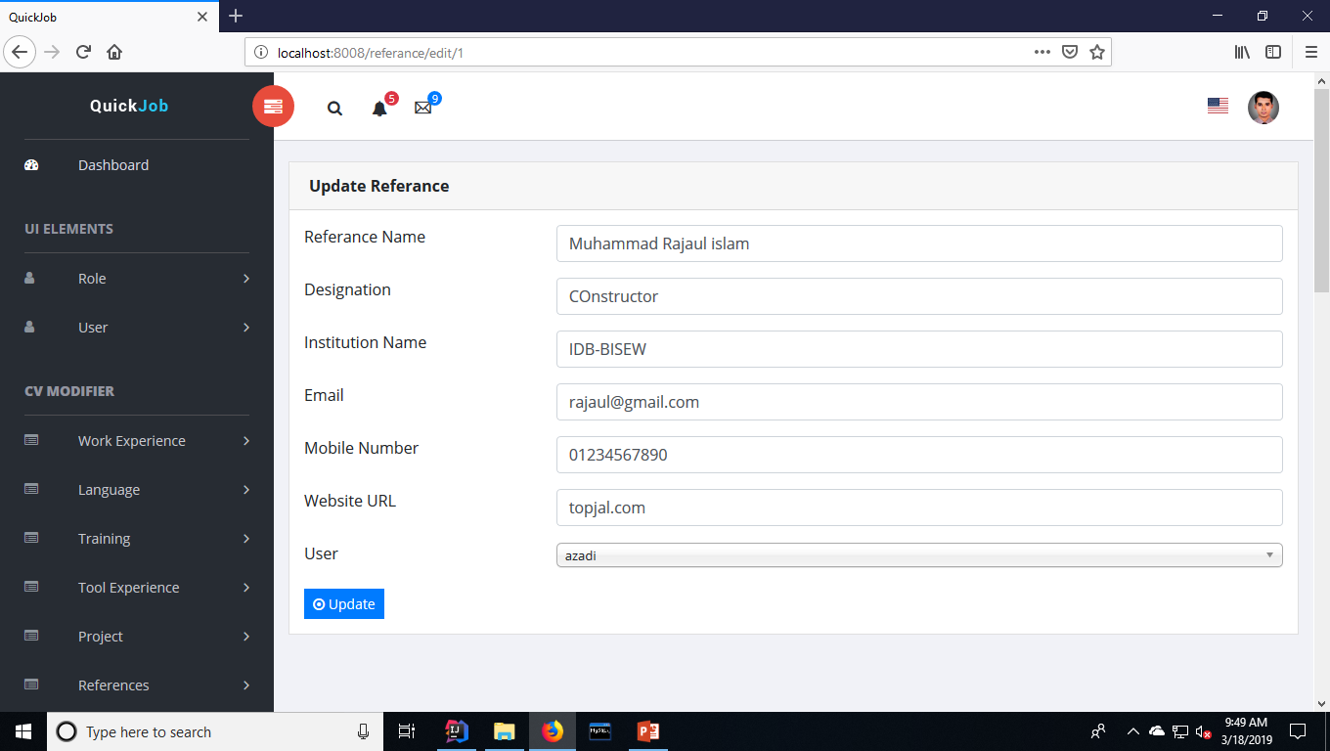

Slide 43
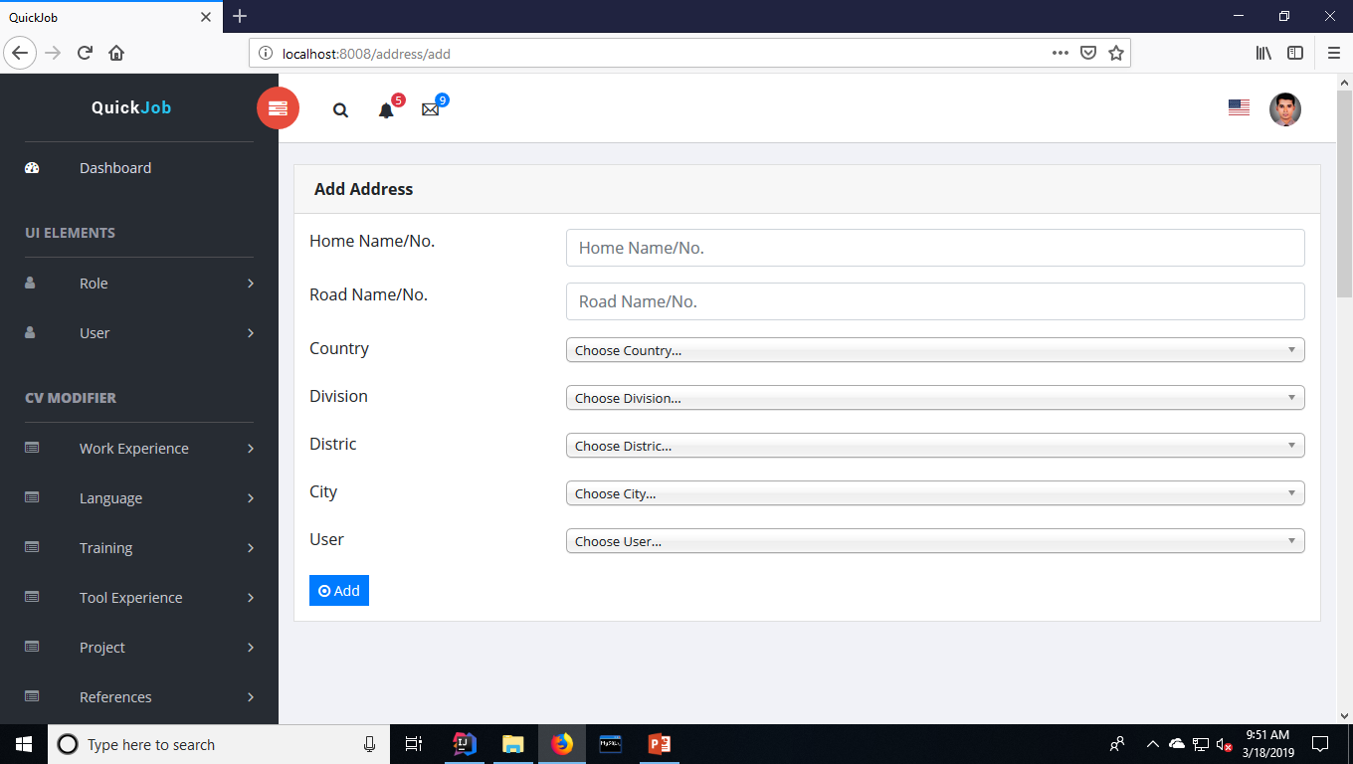

Slide 44
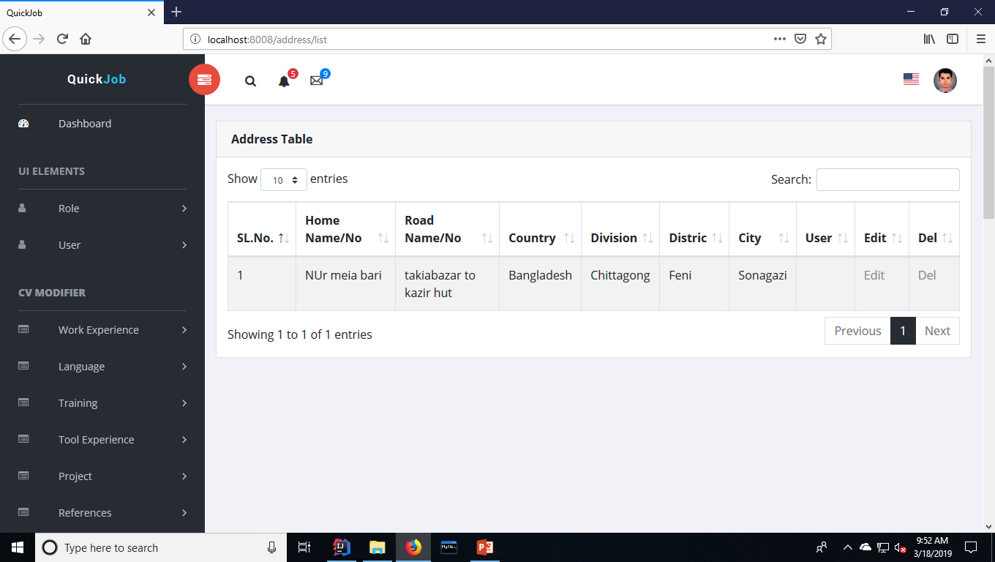

Slide 45
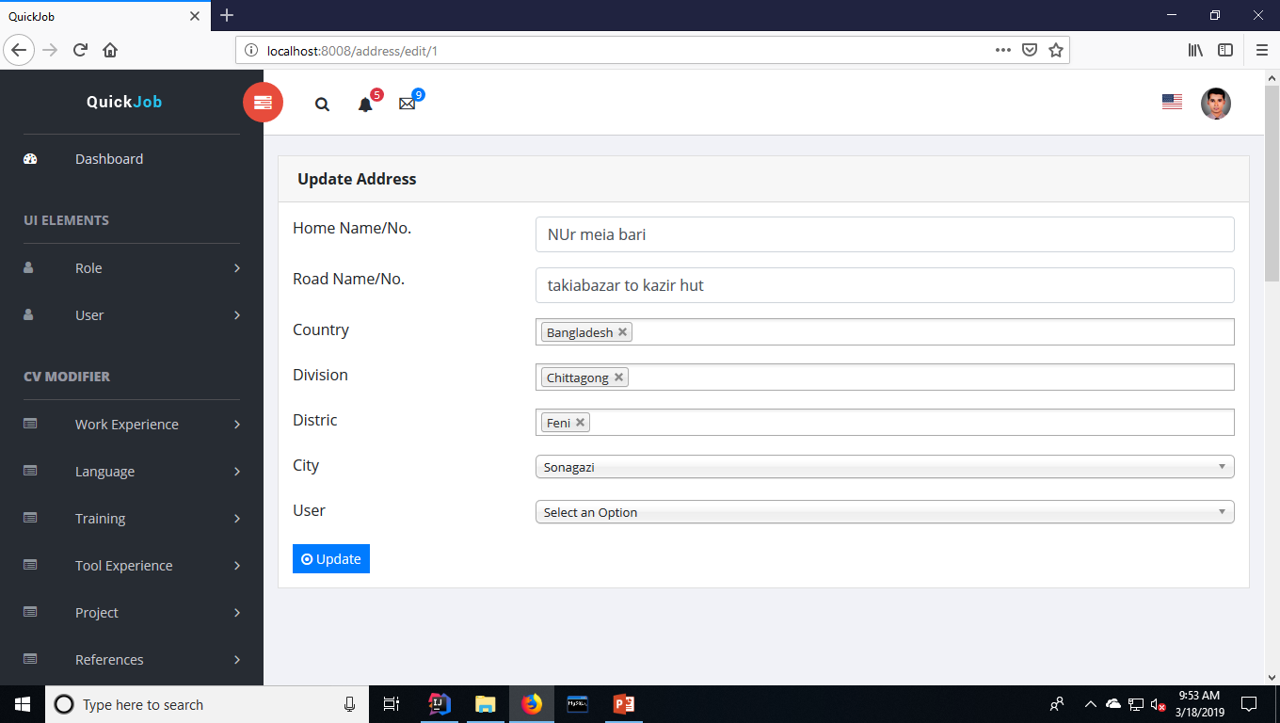

Slide 46


Slide 47


Slide 48
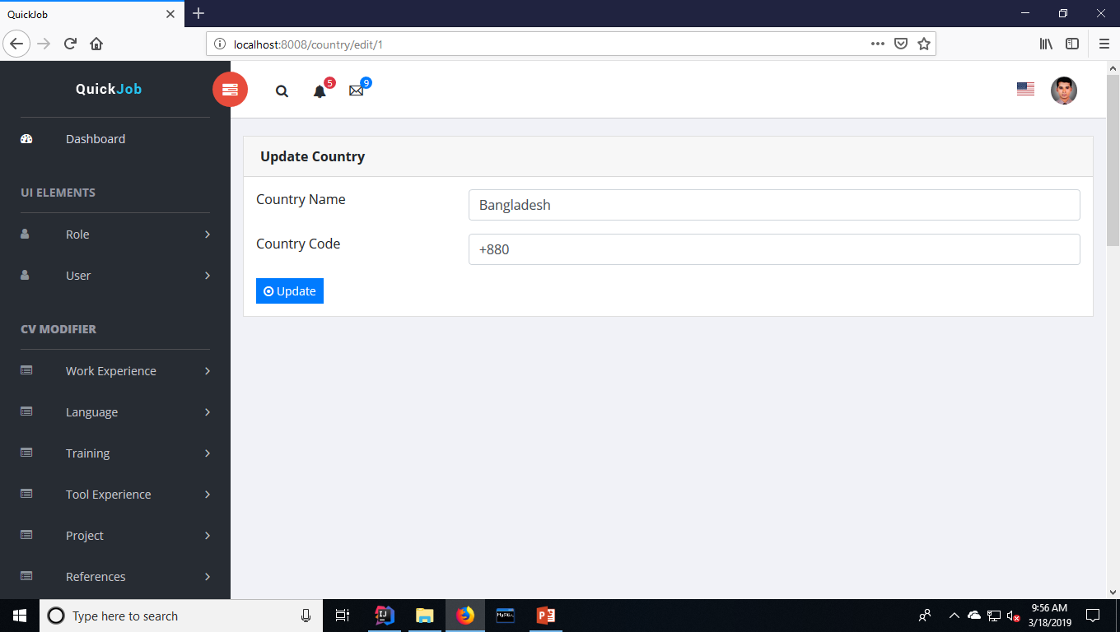

Slide 49
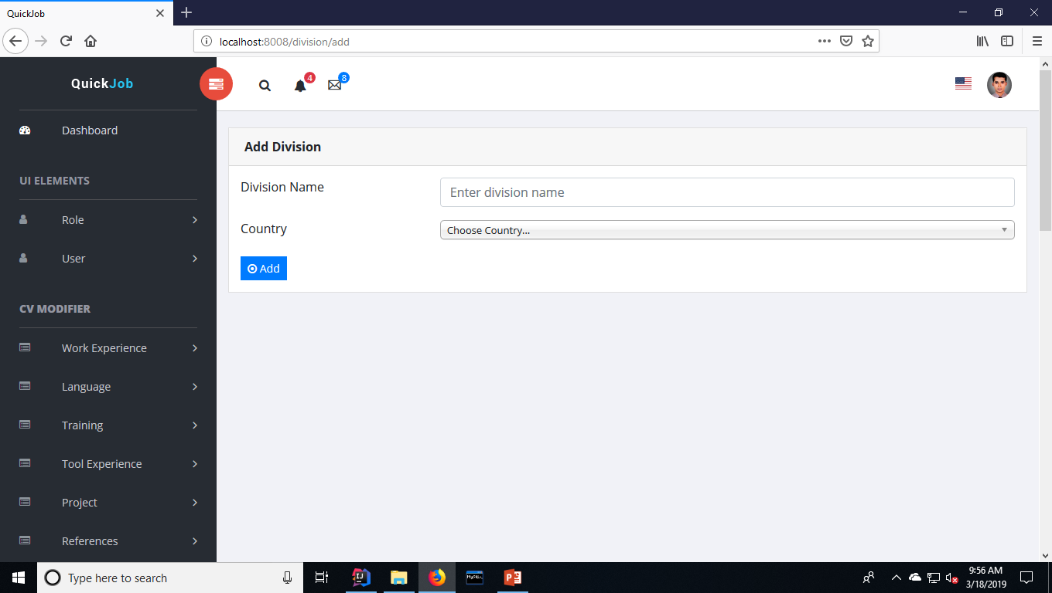

Slide 50
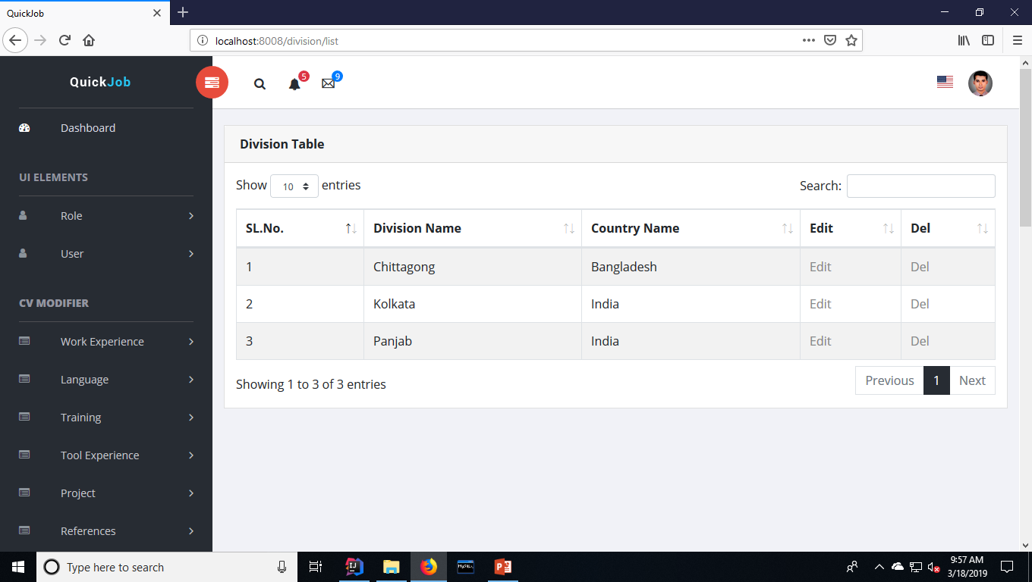

Slide 51


Slide 52


Slide 53
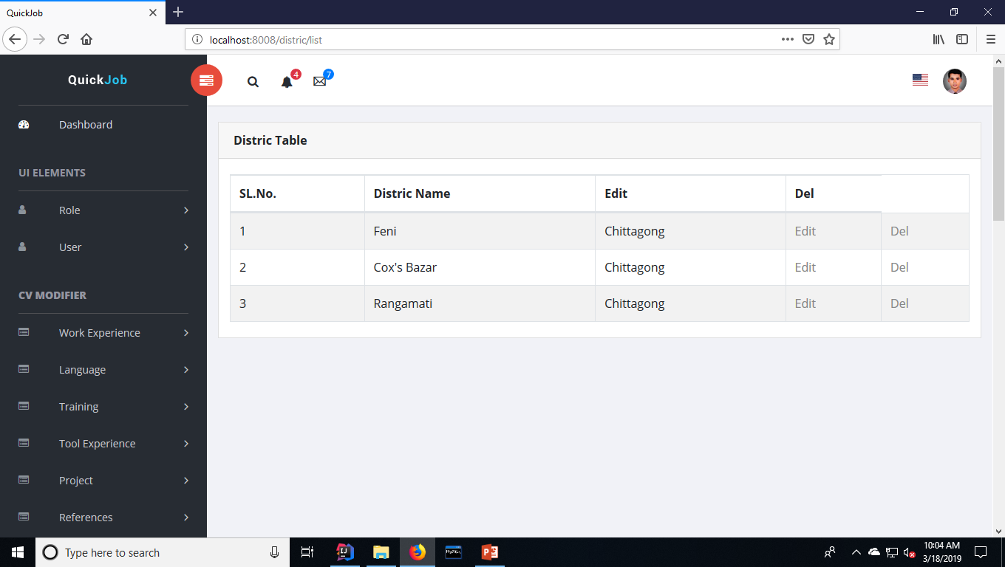

Slide 54


Slide 55


Slide 56
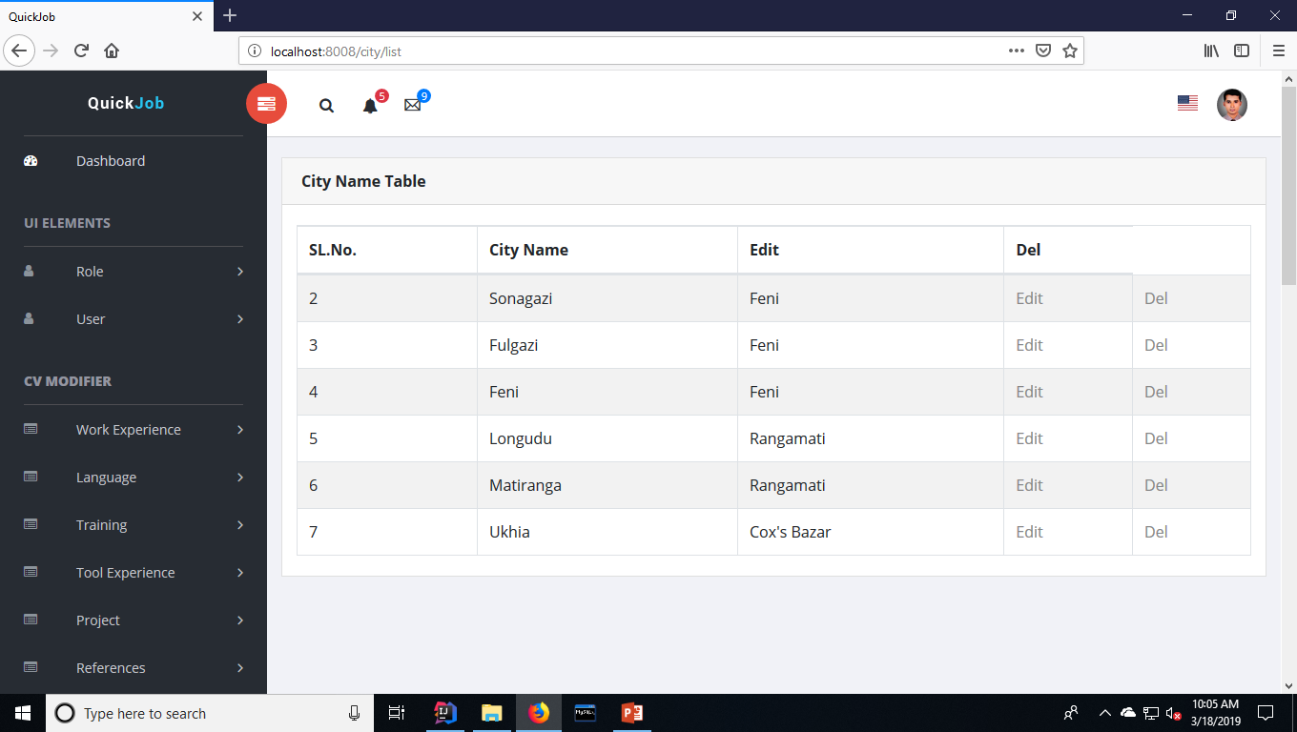

Slide 57


Slide 58
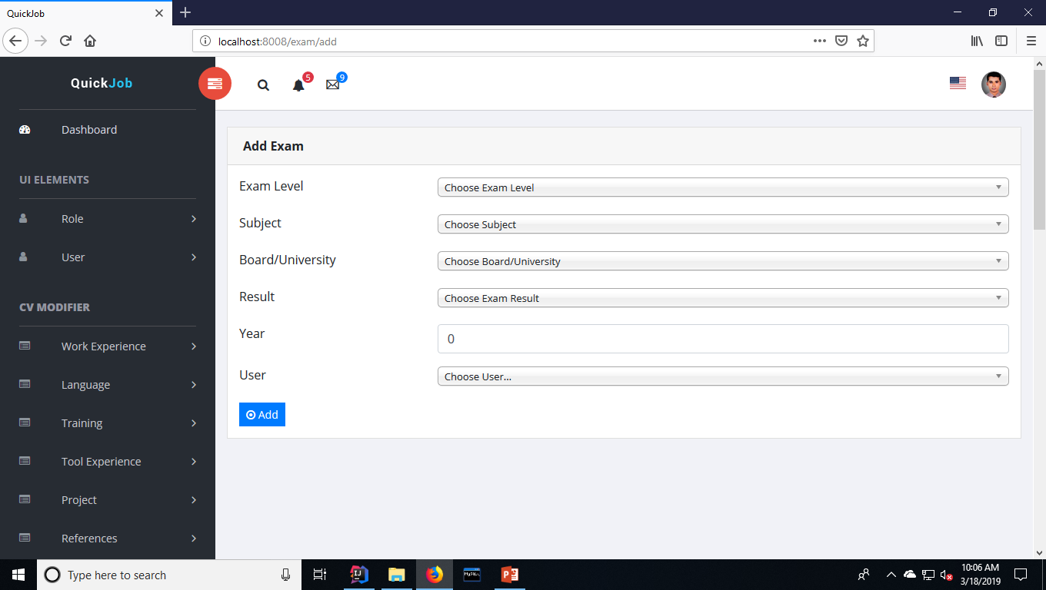

Slide 59
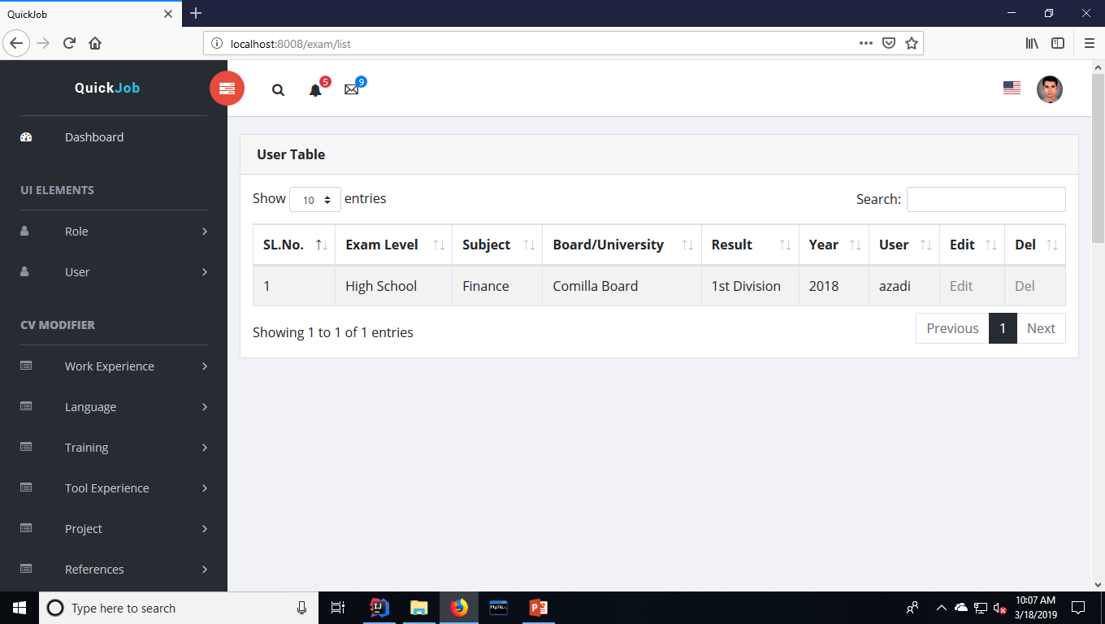

Slide 60
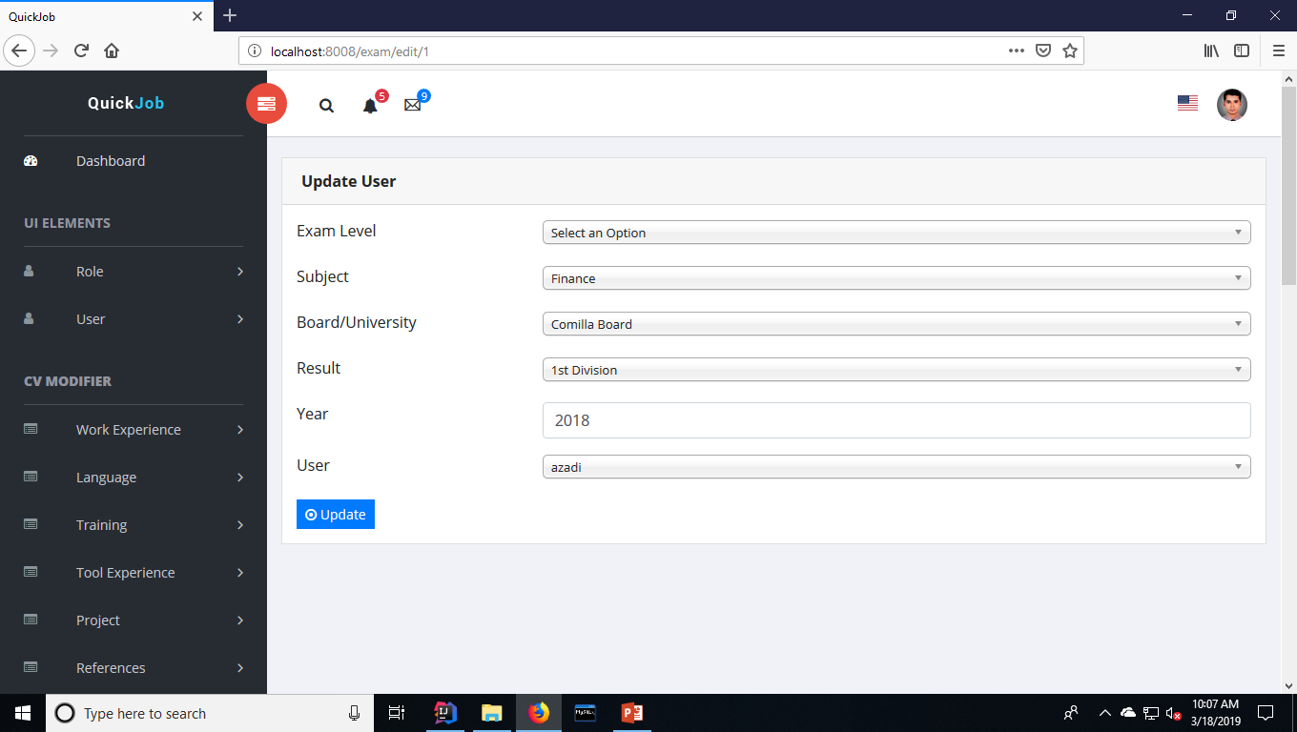

Slide 61
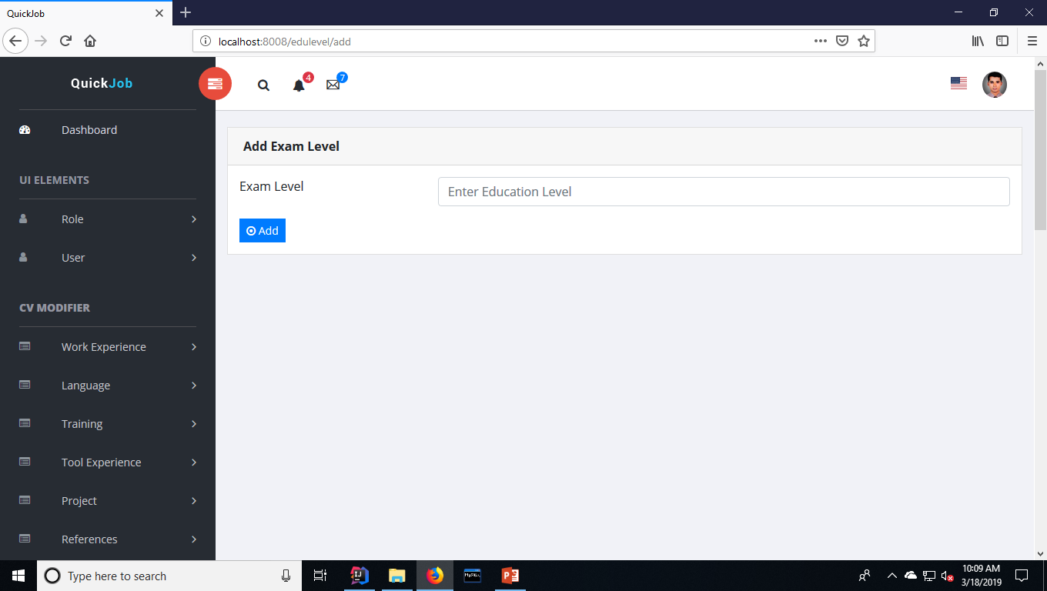

Slide 62
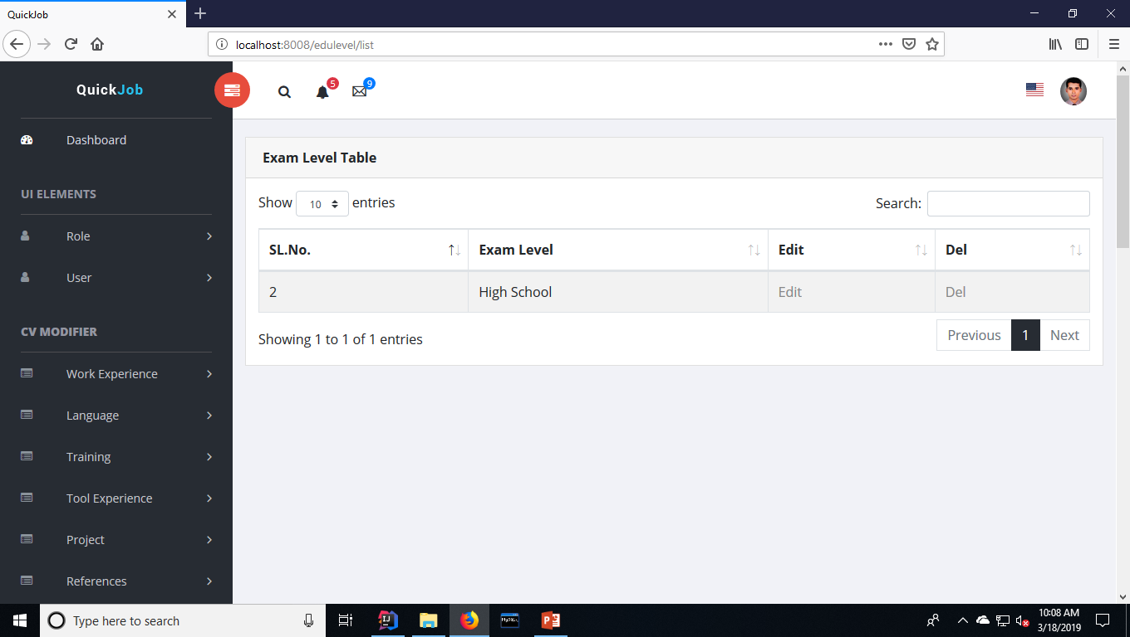

Slide 63


Slide 64


Slide 65


Slide 66


Slide 67


Slide 68


Slide 69


Slide 70


Slide 71


Slide 72


Slide 73
Job Posting

Slide 74


Slide 75


Slide 76


Slide 77


Slide 78


Slide 79


Slide 80


Slide 81


Slide 82


Slide 83


Slide 84


Slide 85


Slide 86


Slide 87


Slide 88


Slide 89


Slide 90


Slide 91


Slide 92


Slide 93


Slide 94


Slide 95


